Slide 1
Urban Transportation Network Analysis
Group 2 Bihan Hou， Xinyue He， Haodong Yang， Minghao Li ，Haihan Tang
2024.7.5

Slide 2

Introduction
This project challenges us to develop a transportation network analysis system. The goal is to model an urban area's bus transportation system using graphs, with stops as nodes and routes as edges. This model will help analyze and improve route efficiency and predict travel times.

Slide 3
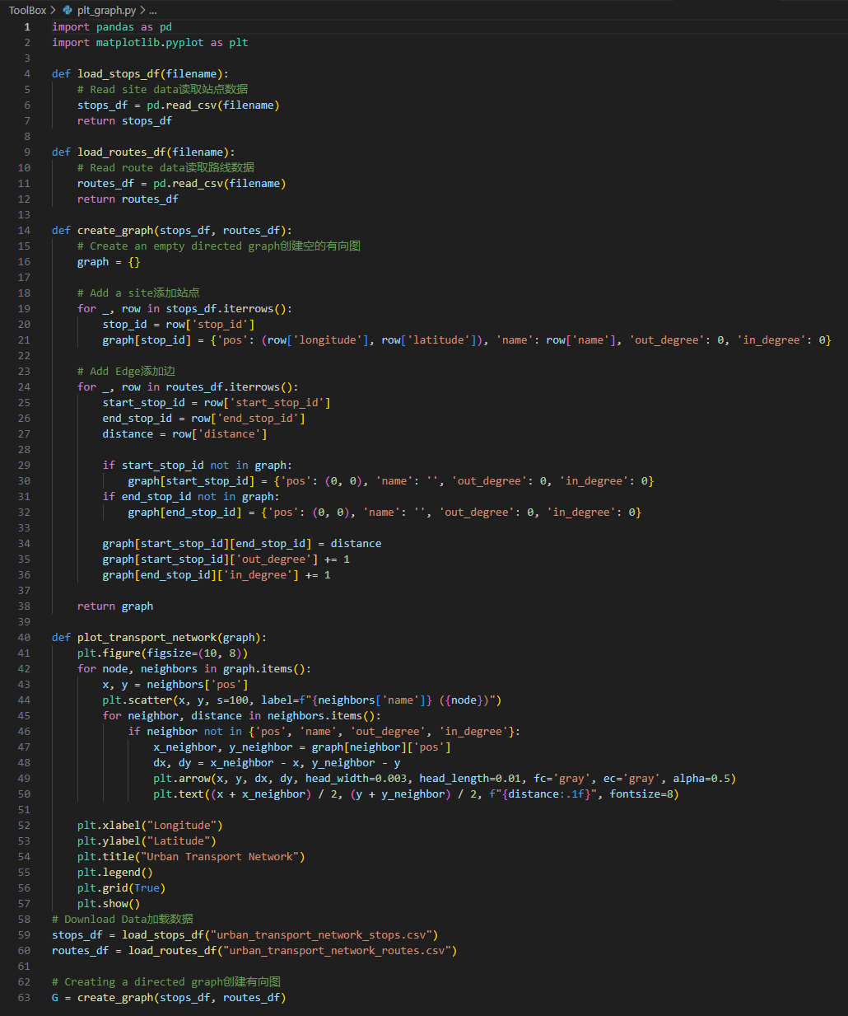
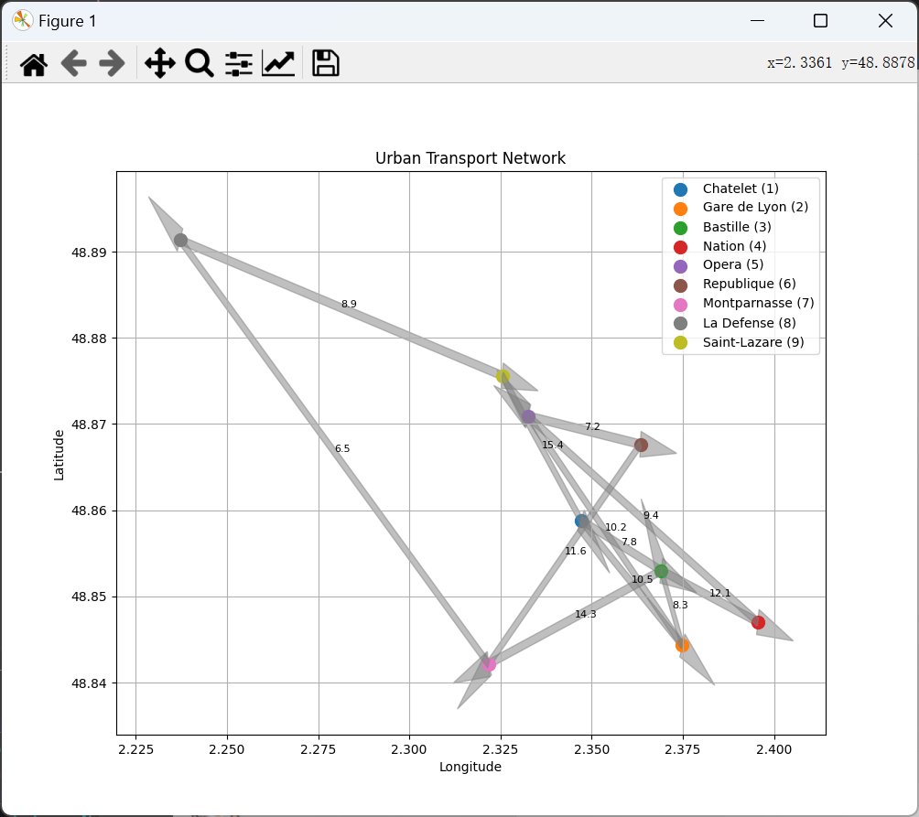
Plot graph
Load the site and route data via the 'load_stops_df' and 'load_routes_df' functions, reading from the specified CSV file respectively and returning 'Pandas DataFrame’.
The create_graph function creates a directed graph
The plot_transport_network function uses Matplotlib to draw a visual picture of the urban transport network, showing the routes and distances between the sites.
The purpose of this code is to analyze and demonstrate the structure and connectivity of the urban transportation network.

Slide 4
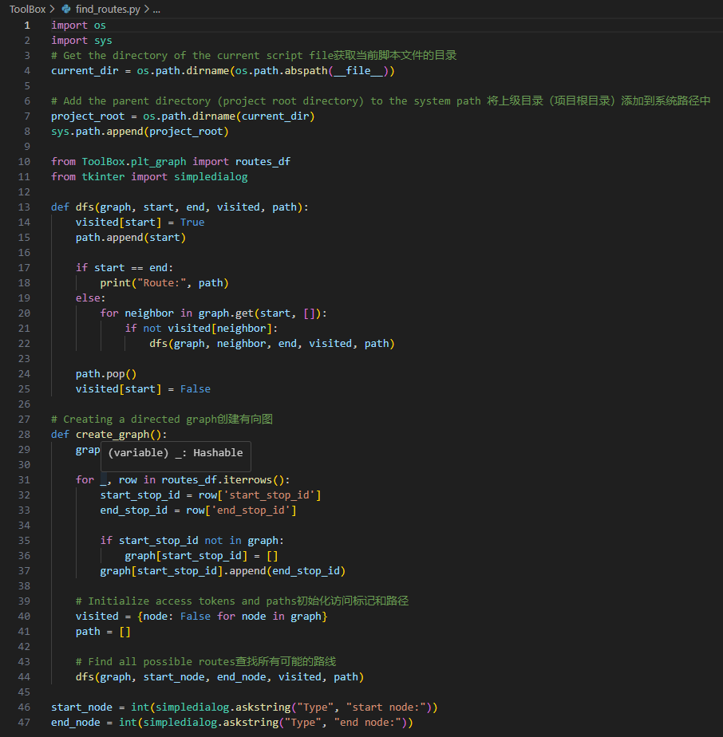
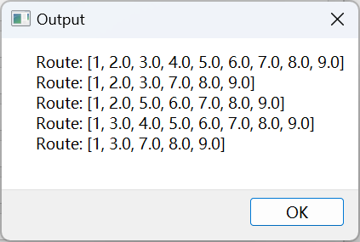
Find routes
In find_routes.py, we implement a path lookup function based on depth-first search (DFS) algorithm.
import 'routes_df' data from the project root as the base data for the roadmap.
a pop-up dialog box is used to get the user's input starting and ending stations, respectively. Using these inputs, the program builds a directed graph and uses DFS to recursively find all possible paths from the origin station to the final station and prints them out.
This code is path search and analysis based on given traffic network data.

Slide 5
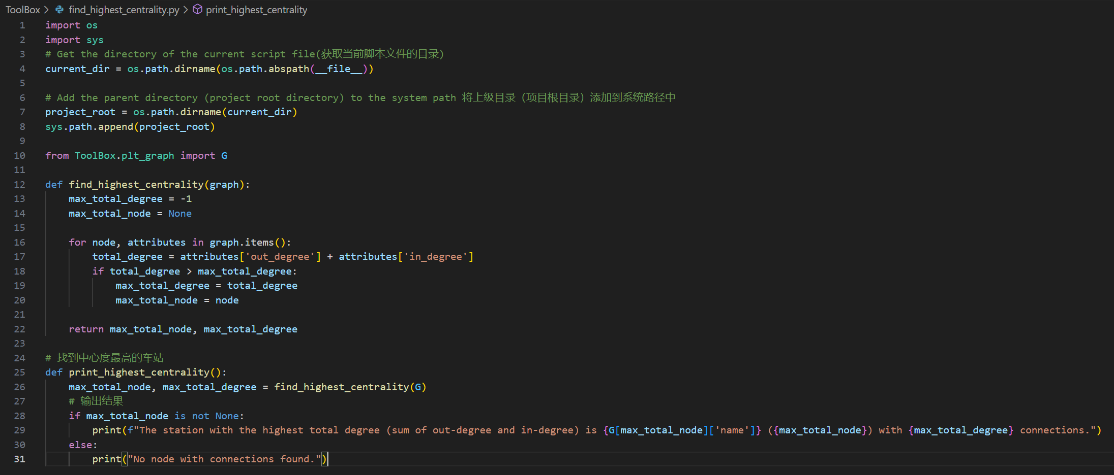
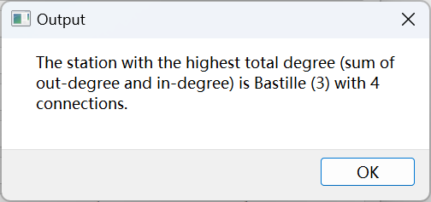
Find highest centrality
In find_highest_centrality.py, this code aims to find the station with the highest centrality from the given graph 'G'. By traversing each node in the graph and calculating its total degree, the node with the largest total degree and its related information are finally determined.
The function 'print_highest_centrality' prints out the name, identification, and number of connections of the station with the highest total number of degrees.
This code is suitable for analyzing and displaying the most critical and busy traffic nodes in the urban transportation network.

Slide 6
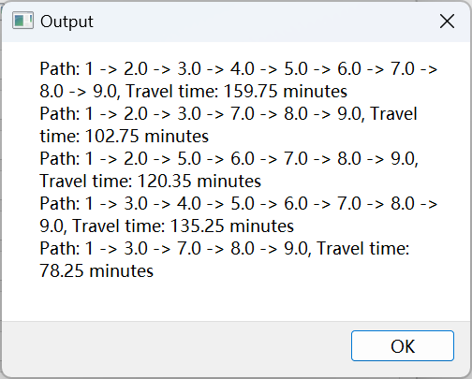
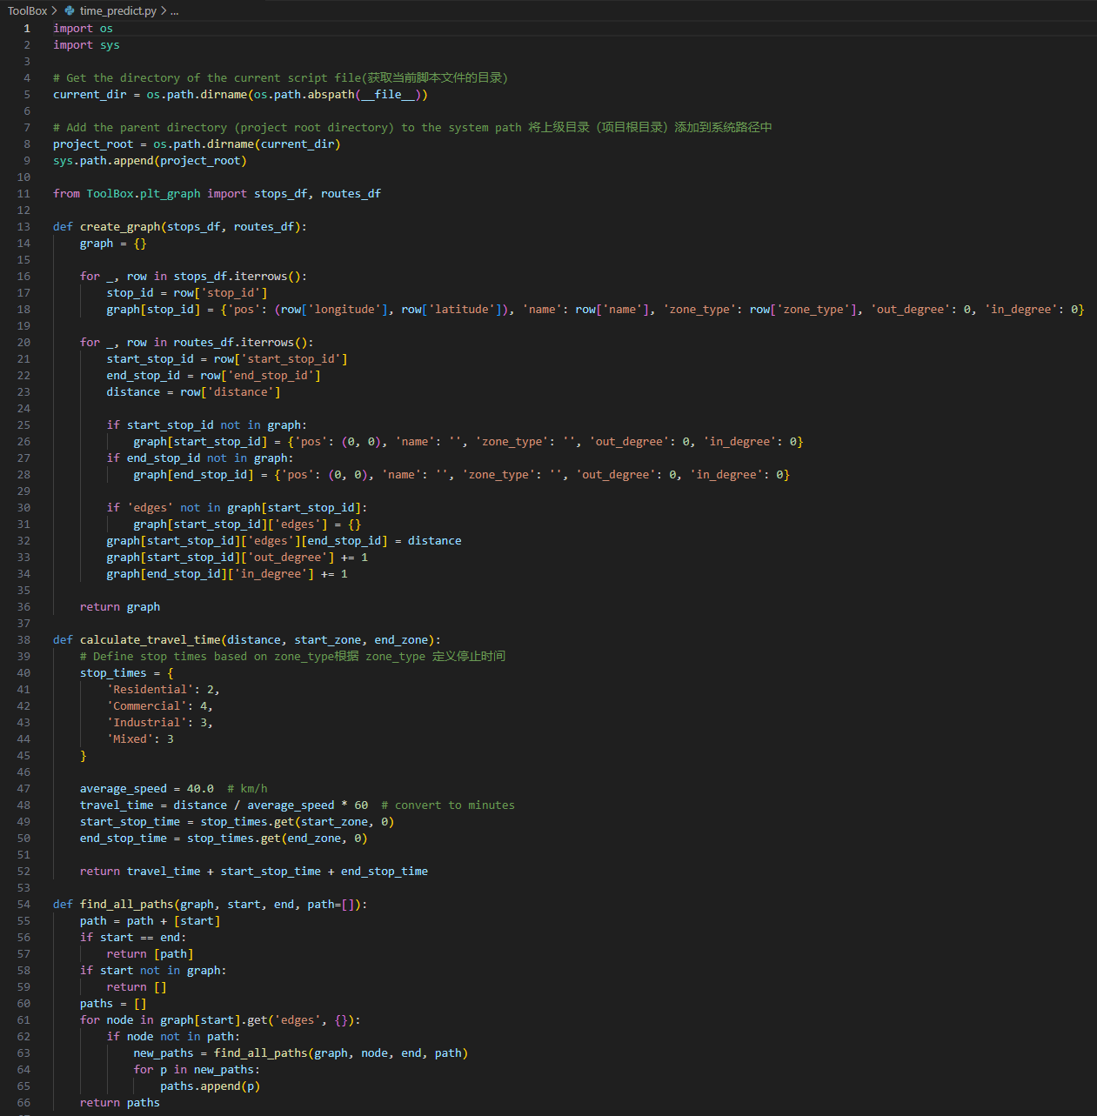
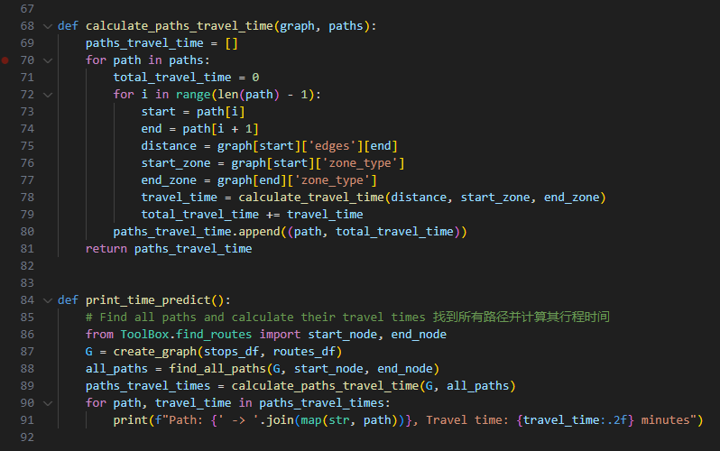
Time predict
time_predict.py implement a traffic network model.
create_graph is used to construct a digraph G based on the given site and route data.
The calculate_travel_time function is defined to calculate the travel time between two stations.
Use the 'find_all_paths' function to find all possible paths between the specified start and end points, and the 'calculate_paths_travel_time' function to calculate the total travel time for each path.
In the 'print_time_predict' function, all the paths and their estimated travel time are printed by calling the aforementioned function.
This code showed the construction process of traffic network analysis model and the realization method of route travel time prediction.

Slide 7
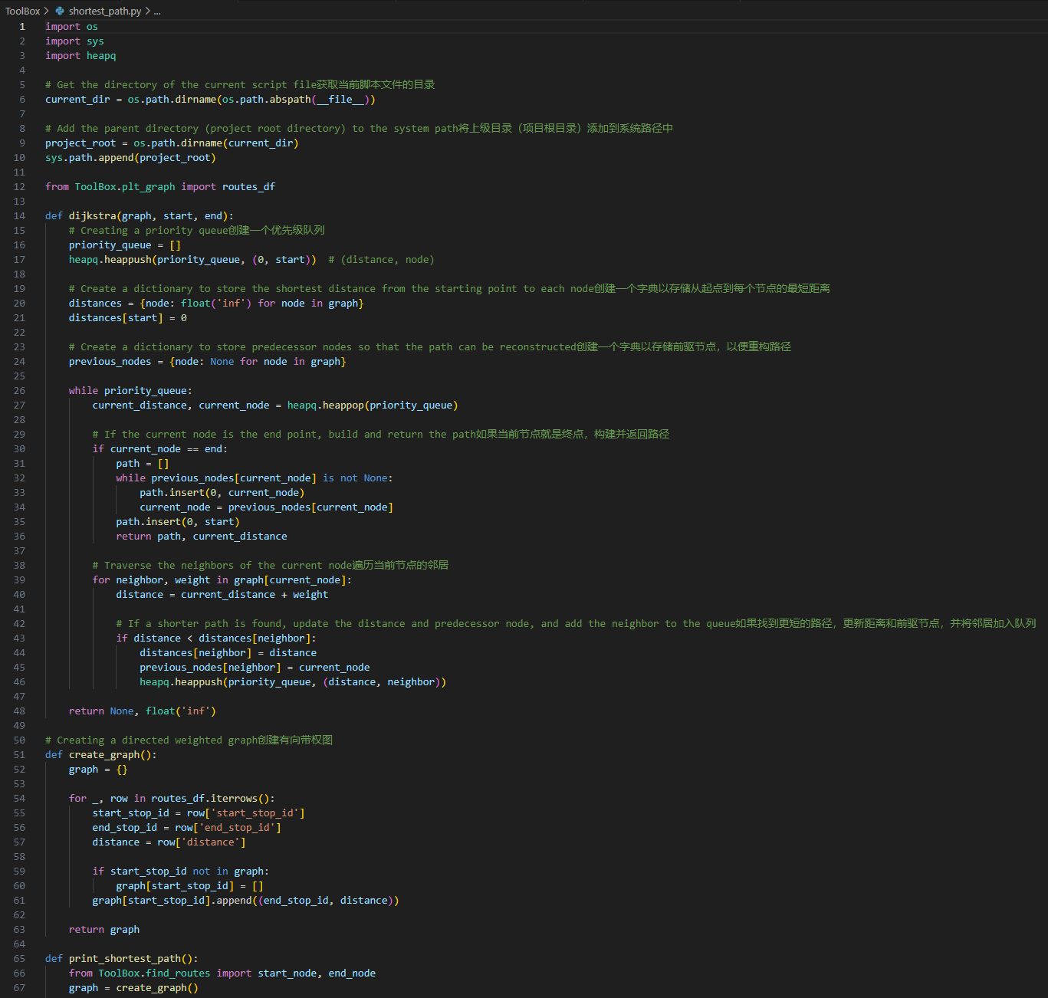
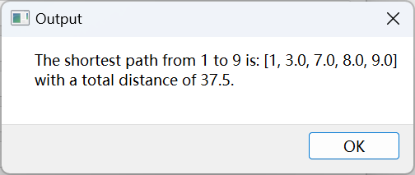
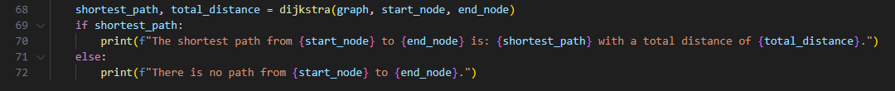
Shortest path
In shortest_path.py, it calculate the shortest path between two points in a weighted directed graph.
A weighted digraph 'graph' is built from the 'routes_df' data box using the 'create_graph' function.
The 'dijkstra' function is used to perform a shortest path search on this graph, from the specified starting point to the end point, to find the shortest path and calculate the total distance of the path.
The result is printed out via the 'print_shortest_path' function, showing the shortest path from the start to the end and its total distance.
The main function of this code is to helps users quickly find the best driving route between two stations by calculating the shortest path and the total distance.

Slide 8
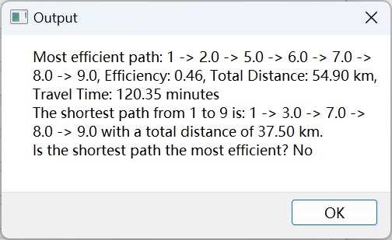
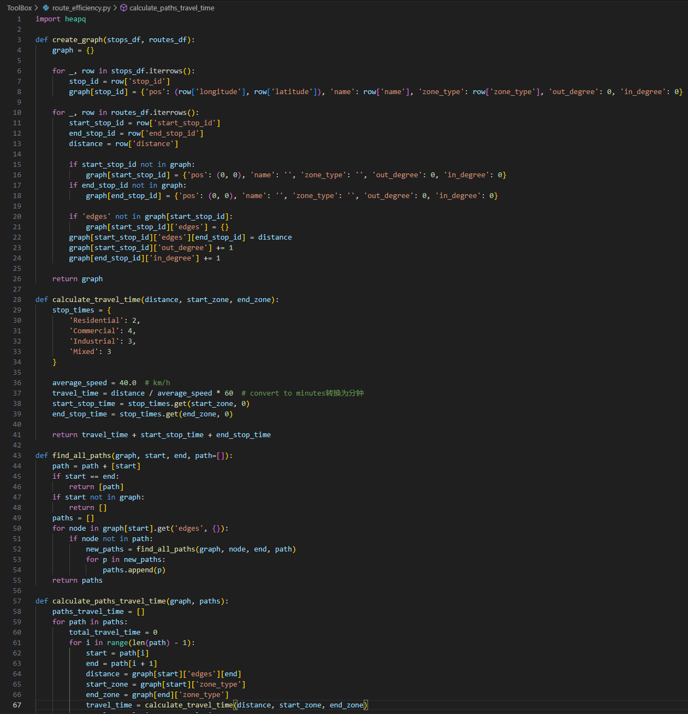
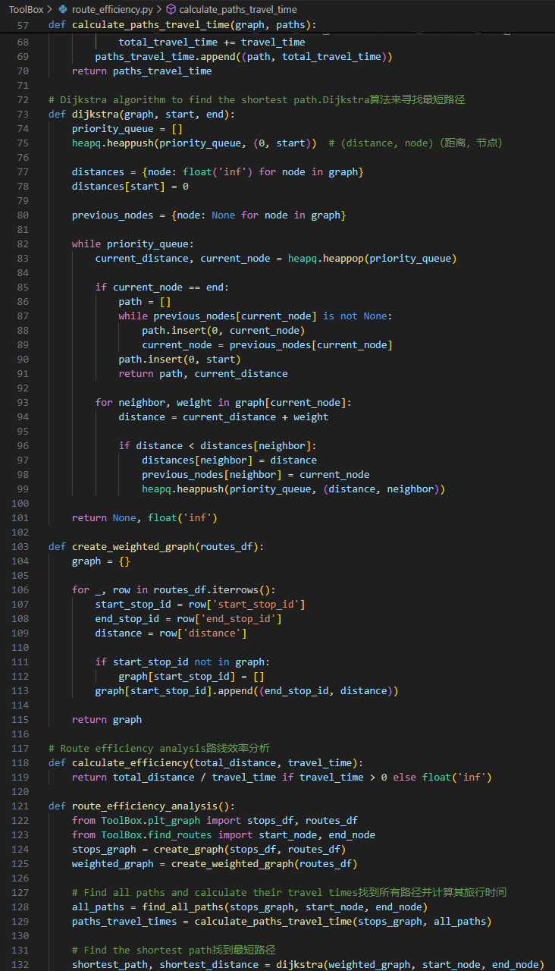
Route efficiency
This code combines stop data and route data to represent the traffic network and the optimal path is found through the path efficiency analysis.
1. Two types of graphs are constructed using the create_graph and create_weighted_graph functions, respectively: an unweighted stop chart and a weighted road map.
2.Dijkstra algorithm is used to find the shortest path between two points in the weighted graph, and the total distance of the path is calculated.
3. the route_efficiency_analysis function was used to analyze the path efficiency to find the most efficient path and compare its relationship with the shortest path.
These functions not only provide the basic capability of path planning, but also evaluate the efficiency and total distance of different paths at a given start and end point to provide the best travel recommendations for the user.

Slide 9
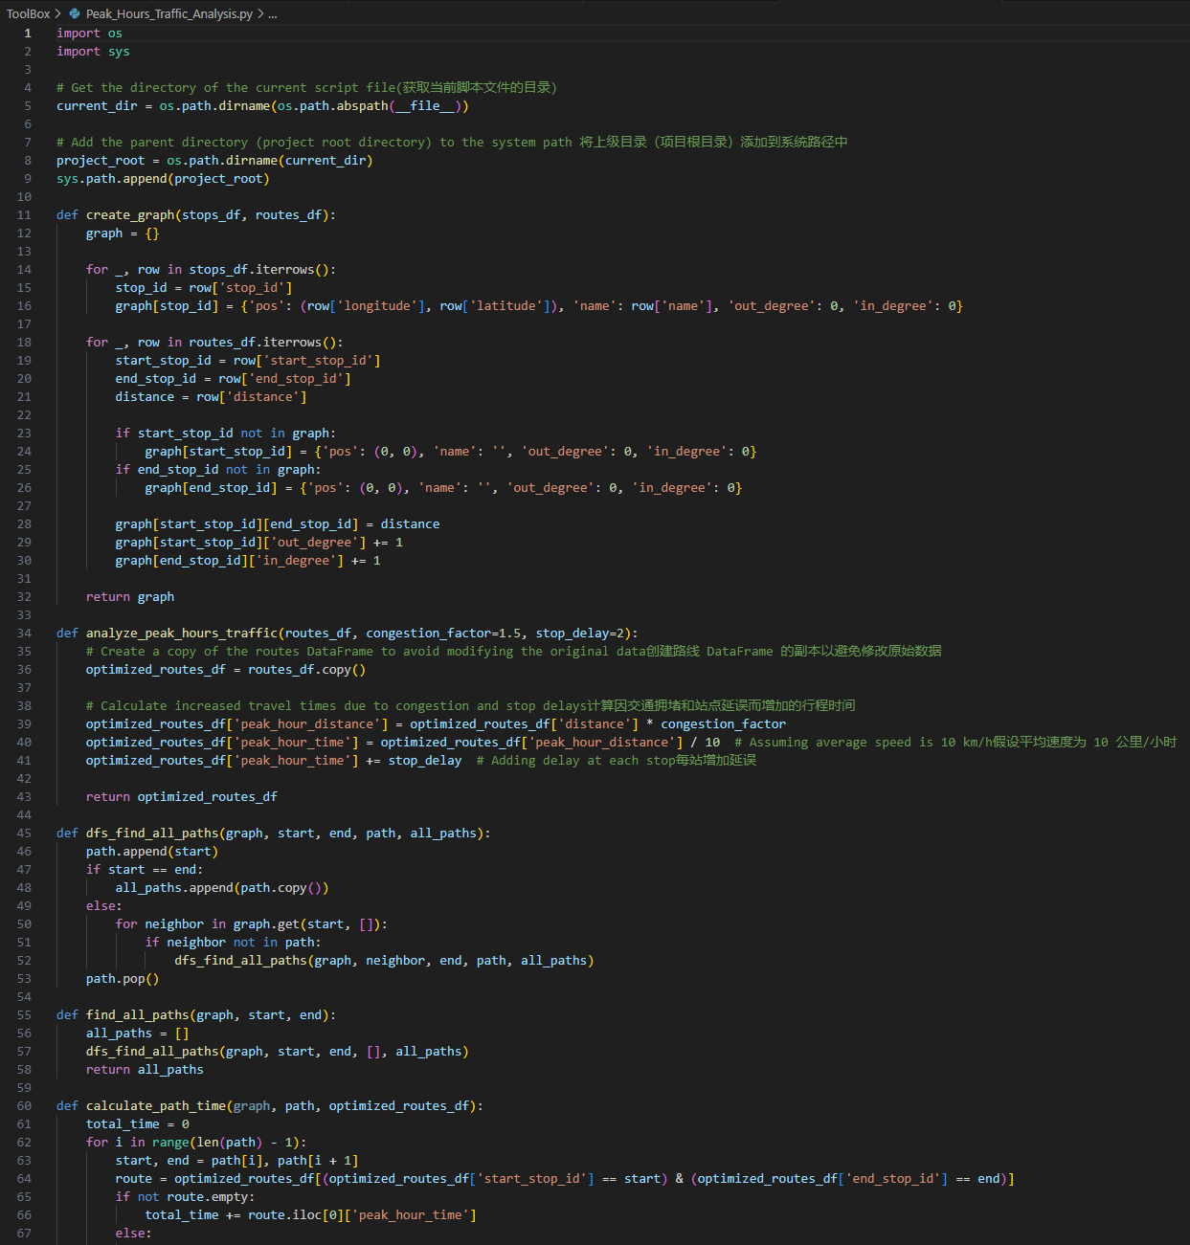
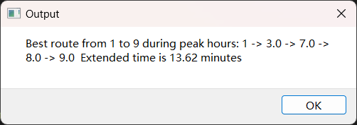
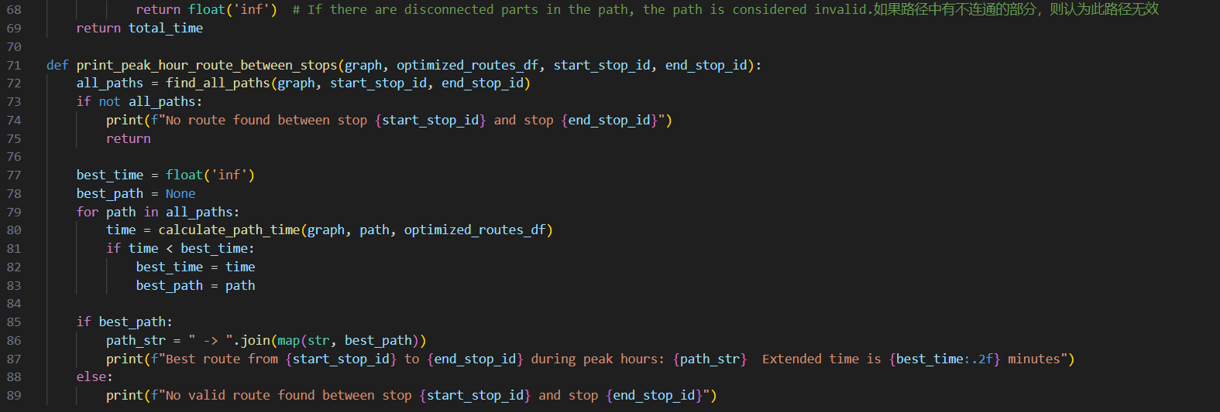
Peak hours traffic analysis
This code implements a functional module for traffic network analysis.
1. The site and routing data is transformed into a graphical representation using the 'create_graph' function, where each site and the connection distance between them are recorded.
2.The analyze_peak_hours_traffic function calculates the optimized routing information during peak hours based on congestion factors and site latency.
3.with the depth-first search algorithm 'dfs_find_all_paths' and 'find_all_paths' functions, all possible paths between the two sites can be found. After the path is determined, the 'calculate_path_time' function calculates the travel time of each path in the optimized routing data frame.
4. The 'print_peak_hour_route_between_stops' function finds the fastest path during rush hours.
The purpose of this code is to provide a complete traffic network analysis function module which can process the station data, routing data, calculate the optimal path and the path travel time.

Slide 10
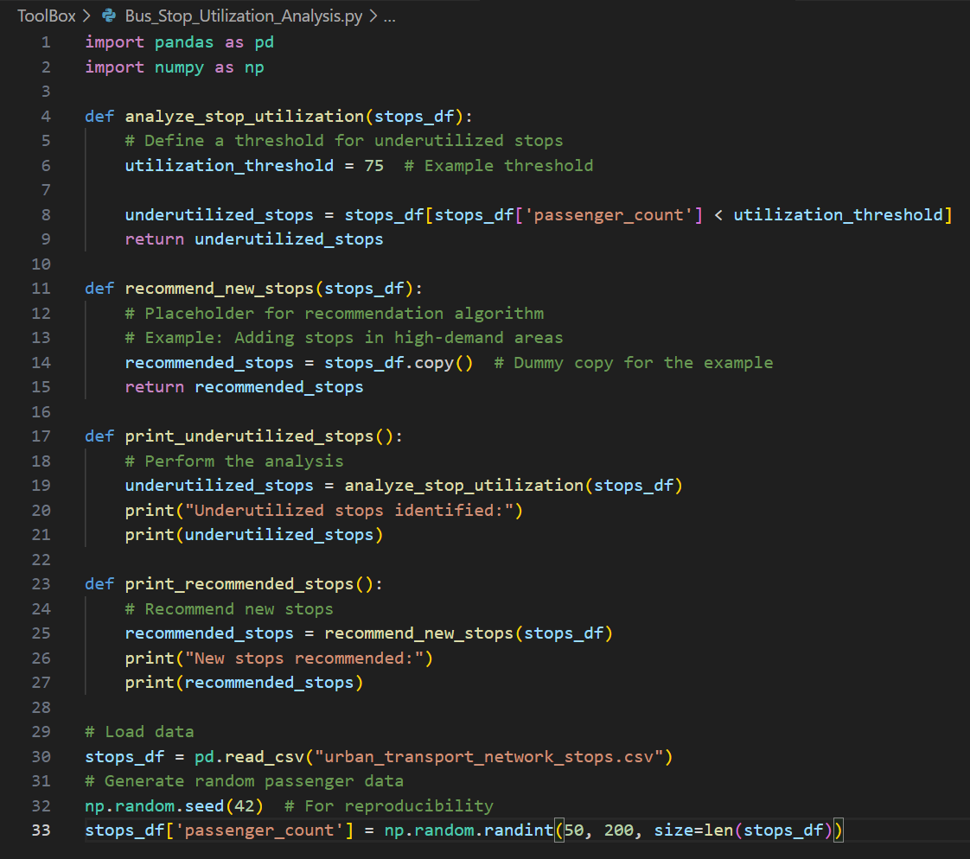
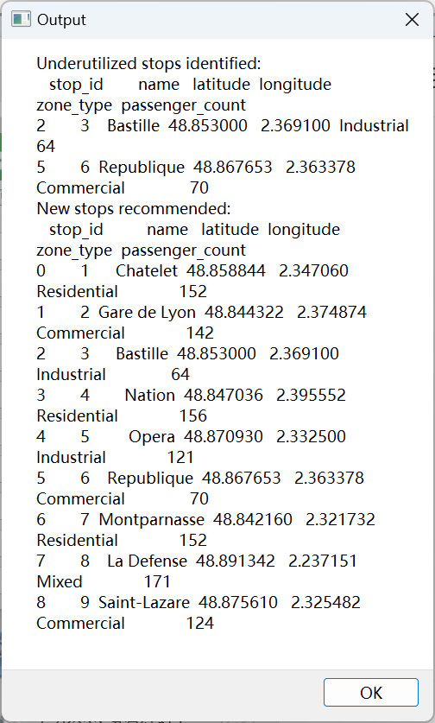
Bus stop utilization analysis
Bus_Stop_Utilization_Analysis.py analyzes the utilization_of an urban transportation network station and recommends new stations.
1.the station information is loaded by reading a data file. Based on the set utilization threshold, the analyze_stop_utilization function identifies underutilized stations where the number of passengers is below the threshold.
2.The 'recommend_new_stops' function acts as a placeholder for the recommendation algorithm and copies the entered site data boxes as an example. The 'print_underutilized_stops' function performs utilization analysis and prints out information about the underutilized sites identified.
3.The 'print_recommended_stops' function calls the recommended_stops function and prints out the recommended-site information.
This code shows how to perform a simple utilization analysis and recommendation algorithm framework based on site data to optimize the site layout and service efficiency of the urban transportation network.

Slide 11
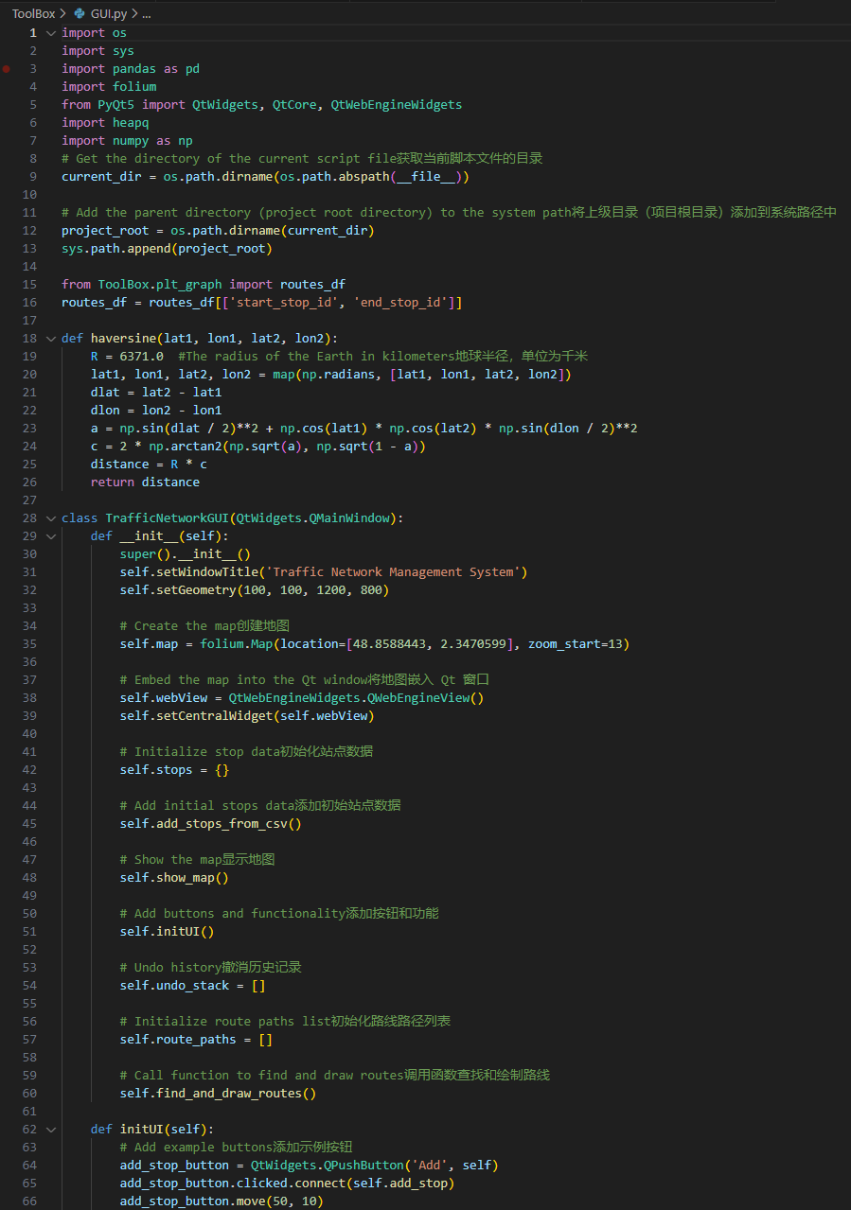
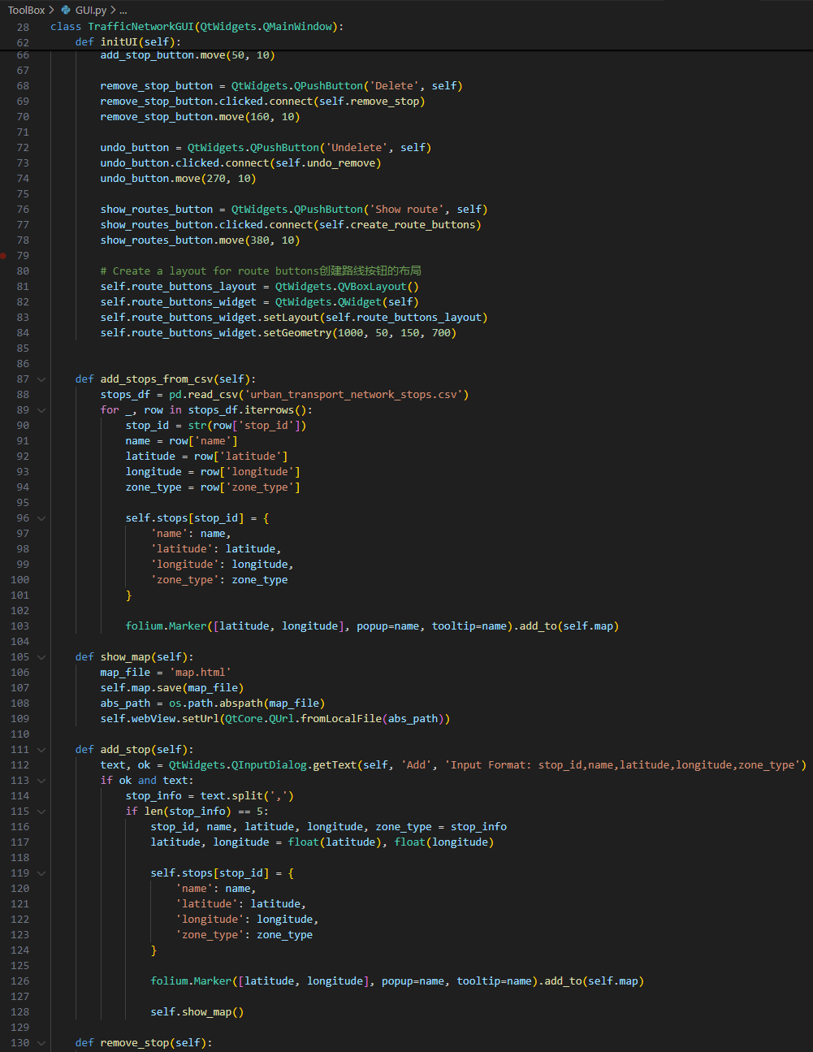
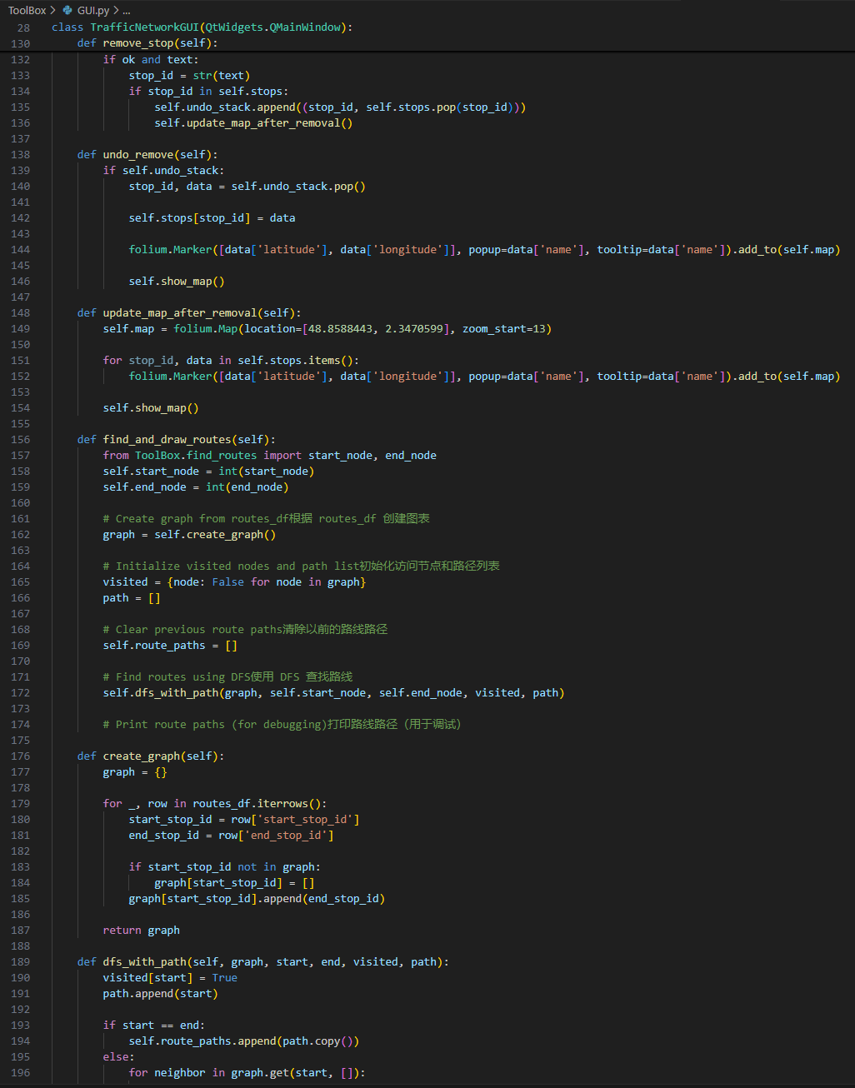
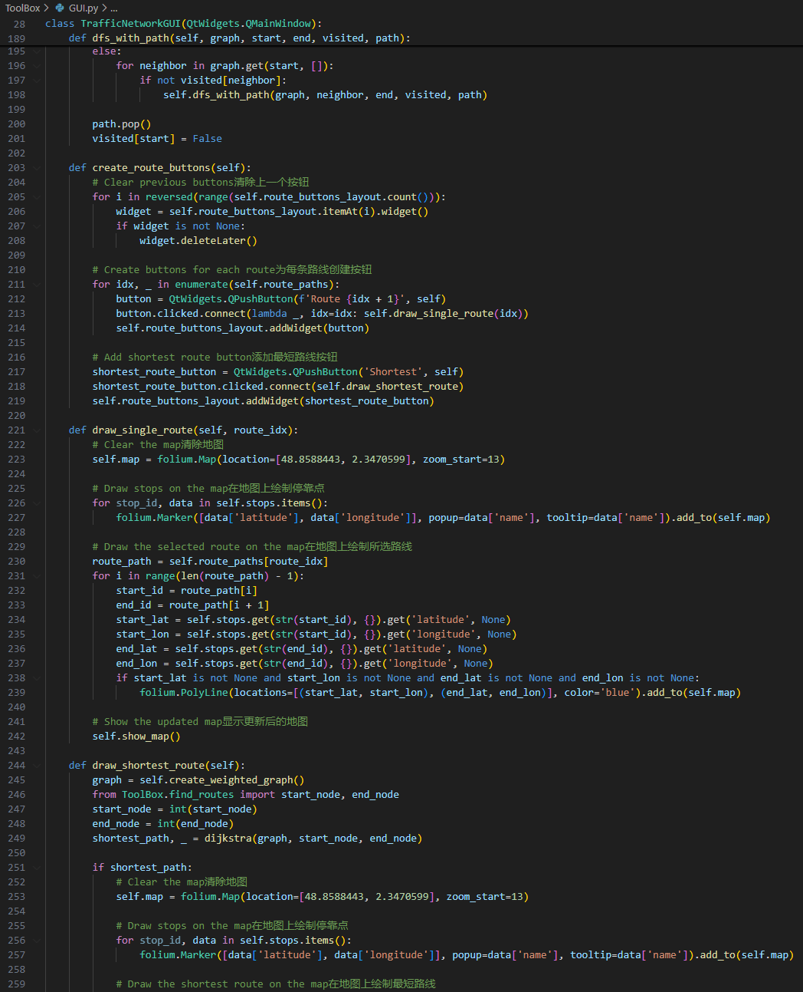
GUI

Slide 12
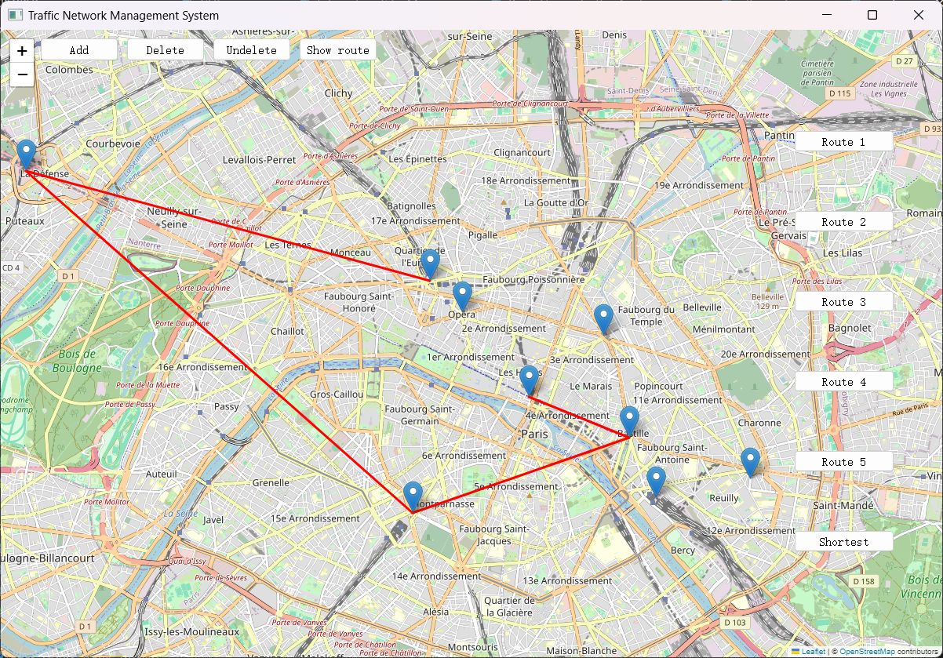

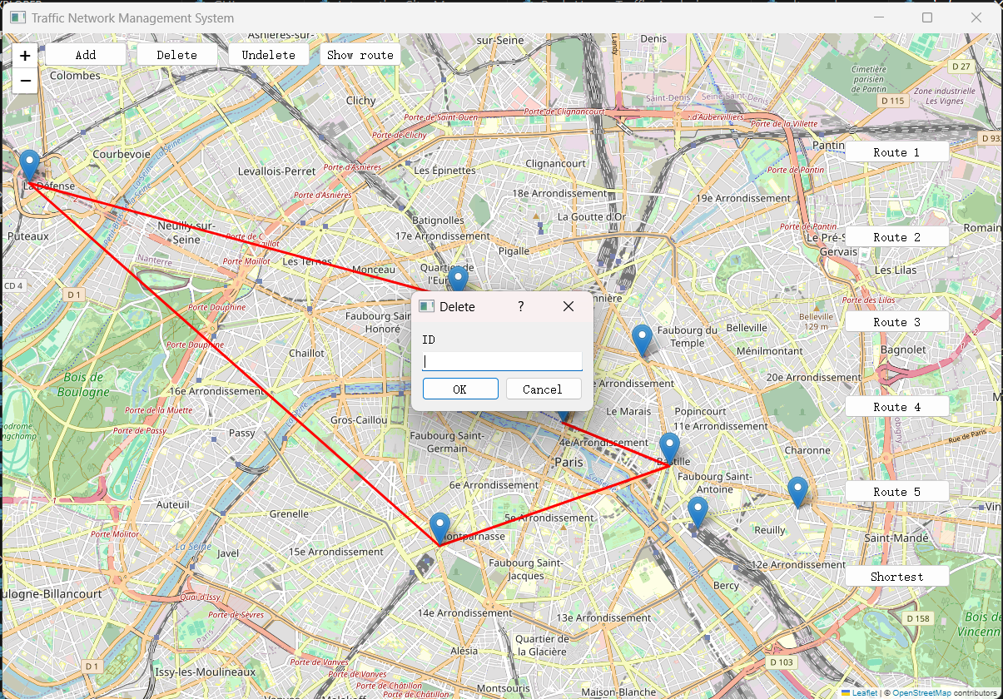
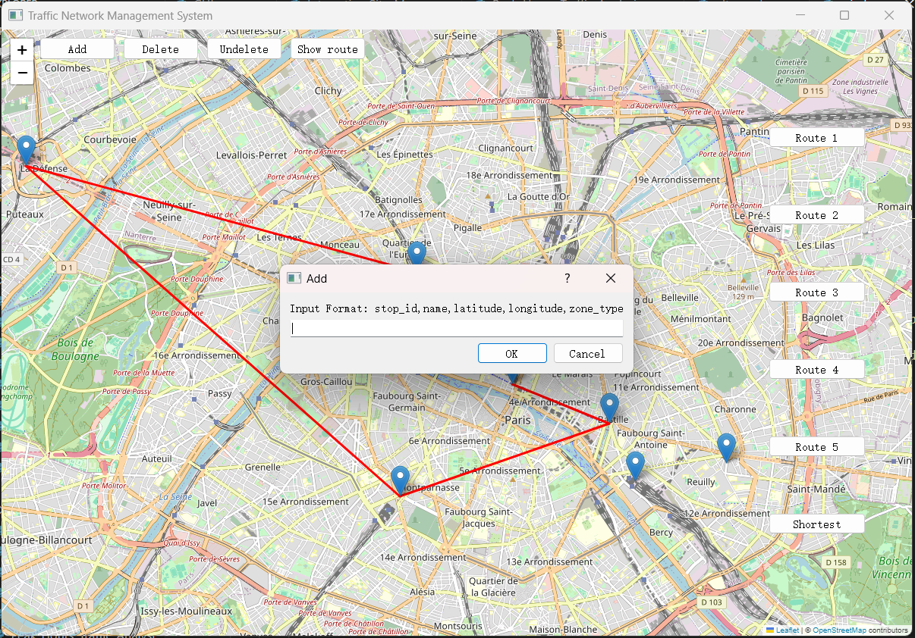
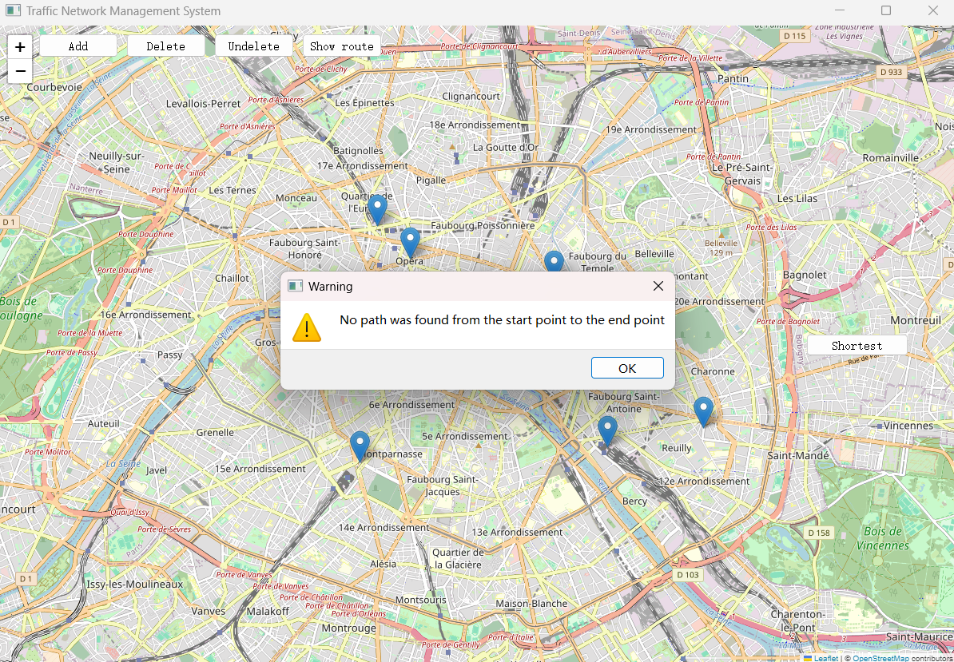
GUI
In GUI.py, it implements a graphical interface program for a traffic network management system, based on PyQt5 and Folium libraries.
The program loads bus stop and route data by reading CSV files, users can add and delete stops on the map, and use depth-first search and Dijkstra algorithm to find and display routes between stops. The interface provides function buttons such as add site, delete site, undo delete, display route. And can draw multiple possible paths and the shortest path on the map.
The overall design makes full use of the combination of data structure, algorithm and graphical interface, and shows the practical application of urban bus network analysis and optimization.

Slide 13
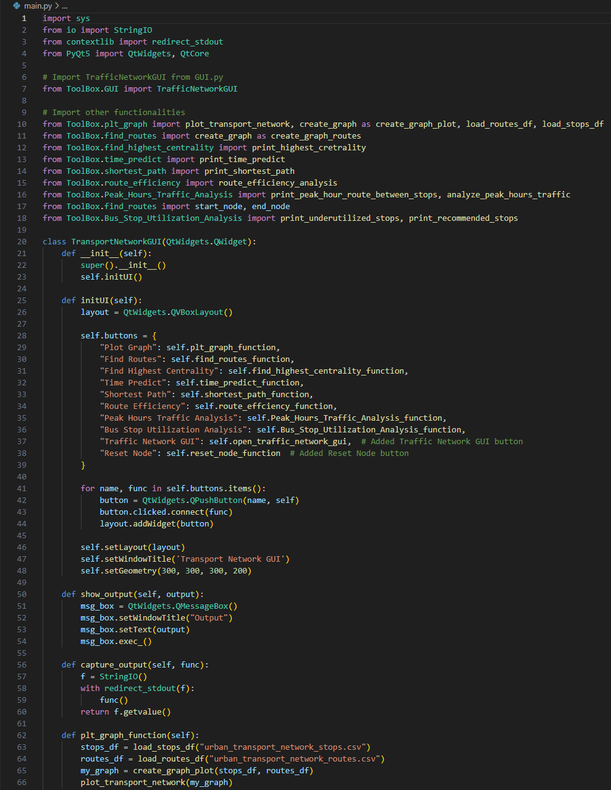
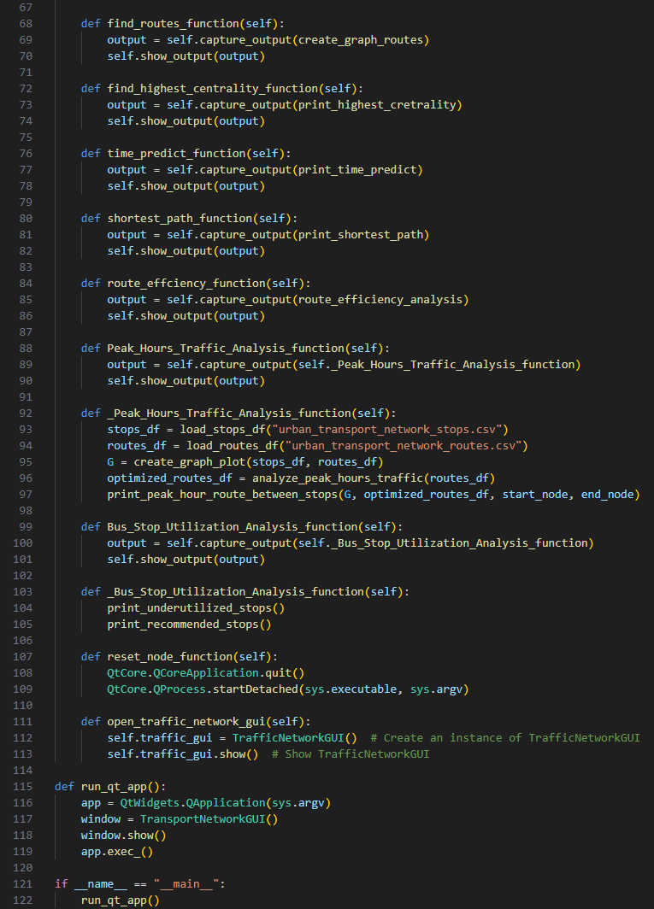
main
In main .py, it implements a PyQT5-based GUI for a traffic network analysis tool. The main functions include calling different traffic network analysis functions by buttons, such as drawing network map, finding path, calculating maximum centrality, time prediction, shortest path, route efficiency analysis, peak hour traffic analysis, bus stop utilization analysis and traffic network GUI. After each button is clicked, the result of the function execution is captured by redirecting the standard output. Also included the function of reset the node. The code and the GUI layout and interaction logic are realized by inheriting the QtWidgets.QWidget class. The signal-slot mechanism provided by PyQt5 is used to deal with button click events, so that users can easily analyze and visualize the traffic network.

Slide 14
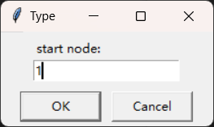
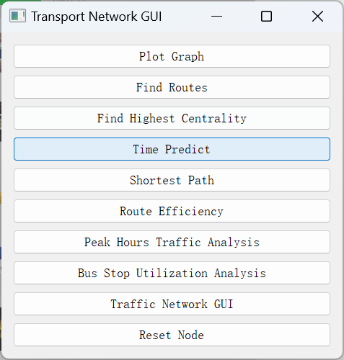
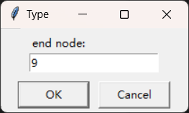
main

Slide 15
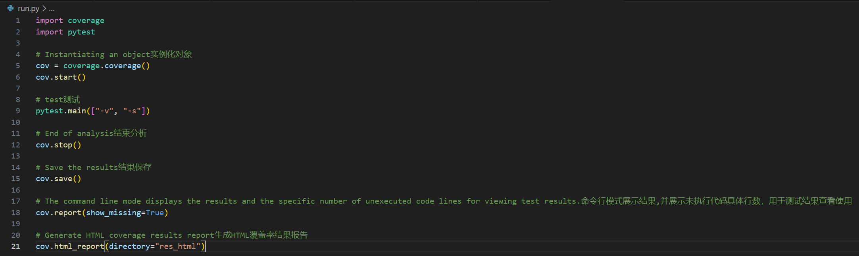
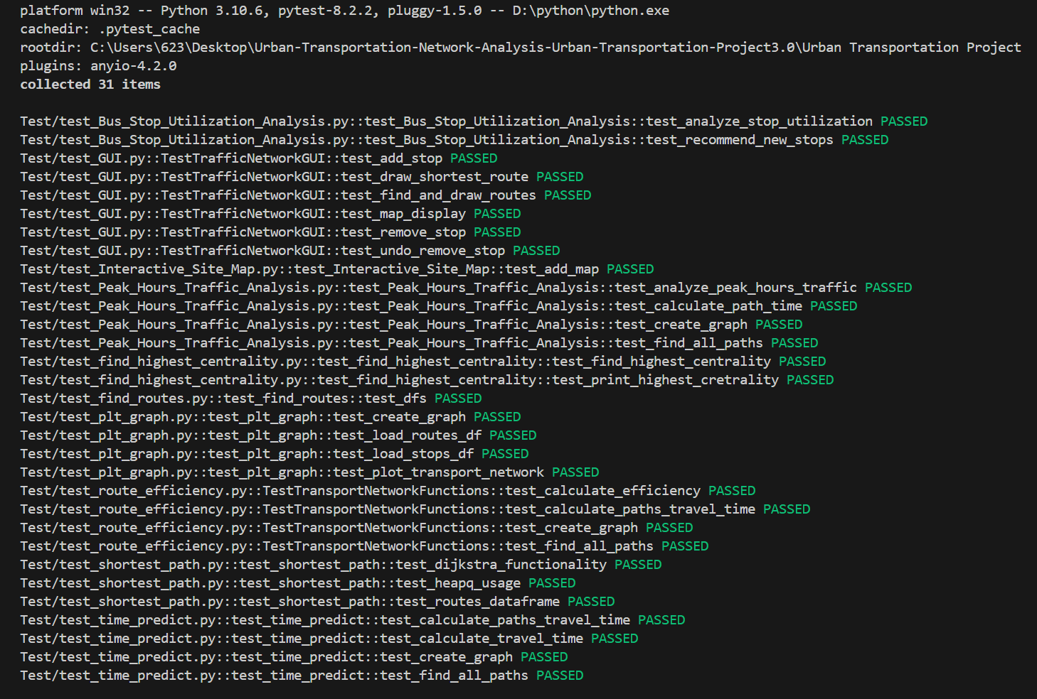
test

Slide 16

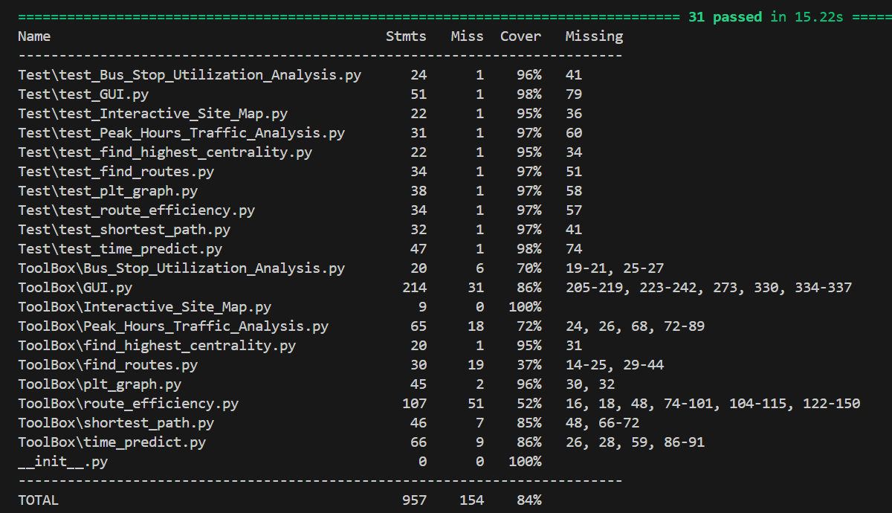
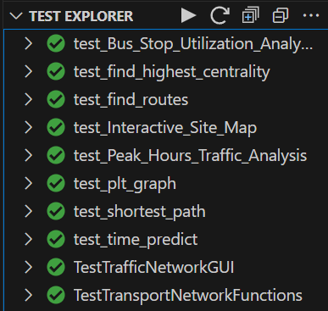
test
The test part is used to test all the codes in ToolBox to ensure the normal operation of the functions. Here we use unittest to test the program, which covers almost all the functions in the program. During test, import several needed libraries, numpy, pandas for example. There are 10 tests and the test covered almost all the functions achieved in the program. After our continuous improvement and testing, the final total coverage rate is 84%. Finally, we use the code coverage extension to show our test coverage rate.

Slide 17

Division
Bihan Hou: Write Peak Hours Traffic Analysis, Bus Stop Utilization Analysis function code, GUI, translation code
Minghao Li: Write time predict, route effciency, test coverage, GUI, main function code
Haodong Yang: Write find highest centrality, shortest path, GUI, main function code
Xinyue He: Write plt graph, find routes function code, write PPT and speech report
Haihan Tang: Write Test function code

Slide 18
Thank you!

